Slide 1

ServiceMaster
Presented by:
Shreeya Pathak

Slide 2
Project Overview
Objective:
To design and develop a secure, scalable, full-stack Service Management System that centralizes the handling of Service Requests, Technician Assignments, Scheduling, Billing, and Reporting for a service-based organization.
The system aims to improve coordination between Customers, Technicians, and Managers, enhance service efficiency, and provide actionable insights through dashboards and reports using modern web technologies and clean architectural practices. Duration: 10 days

Slide 3
Problem Statement
Service requests are currently handled manually through calls and emails, leading to inefficiency and errors.
There is no centralized system to track service requests, assignments, or service status.
Managing technicians, schedules, and service workloads is difficult and unorganized.
Delayed service resolution results in poor customer experience and reduced service quality.
Lack of dashboards and reports limits visibility into service performance and decision-making

Slide 4

Solution
Developed a single unified web-based system to manage all service-related activities.
Implemented role-based system architecture for: Admin, Service Manager, Technician, Customer.
Ensured secure authentication using JWT.
Streamlined Service Request Management.
Integrated Billing & Payment Workflow.
Reporting & Decision Support

Slide 5

Key Features
Role-Based Access Control (RBAC) for Admin, Service Manager, Technician, and Customer Digital service request lifecycle
Online Service Request Management with priority, category, and issue tracking Real-time service status updates
Technician Assignment & Scheduling with workload visibility
Real-Time Status Updates & Notifications for service progress tracking
Integrated Billing & Payment Approval System with invoice generation
Service History & Audit Trail for transparency and accountability
Analytics & Reporting Dashboard for performance and decision support

Slide 6
Tech Stack
FRONTEND
BACKEND
Angular (latest version)
TypeScript
Angular Material / Bootstrap
Reactive Forms
HTTPClient & Interceptors
ASP.NET Core Web API (.NET 8/9)
Entity Framework Core
LINQ for data querying
SQL Server
JWT Authentication & Authorization
Swagger / OpenAPI

Slide 7
Key Roles
ADMIN | CUSTOMER | SERVICE MANAGER | TECHNICIAN
Manages users, roles, and system configuration | Registers/logs in and raises service requests | Reviews and validates service requests | Views assigned service requests
Manages service categories and services | Tracks service status and views service history | Assigns technicians and schedules services | Performs service tasks as scheduled
 | Makes payment after service completion | Monitors service progress and resolution | Updates service status and remarks

Slide 8
System Architecture

Slide 9
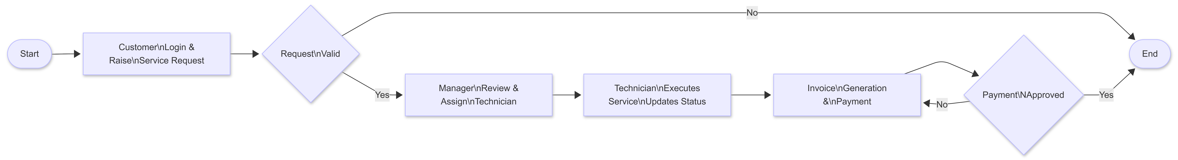
Service Request Workflow

Slide 10
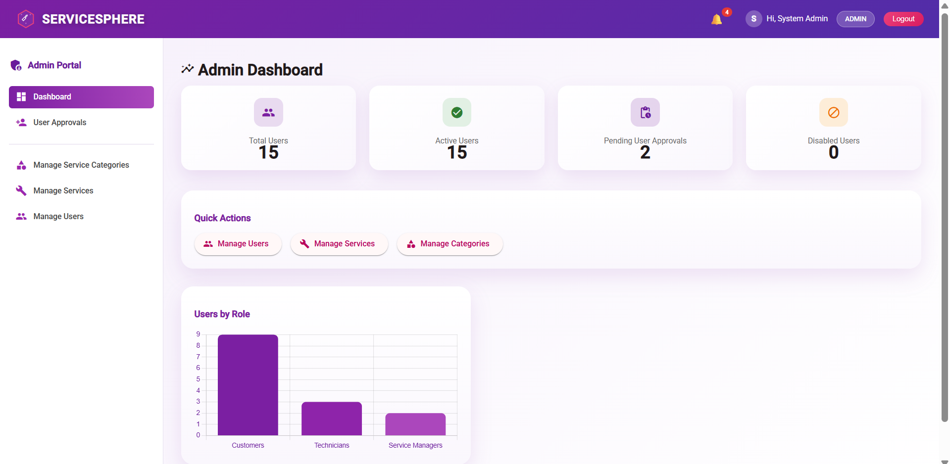
ADMIN DASHBOARD
Architecture
Construction
Urban Planning

Slide 11
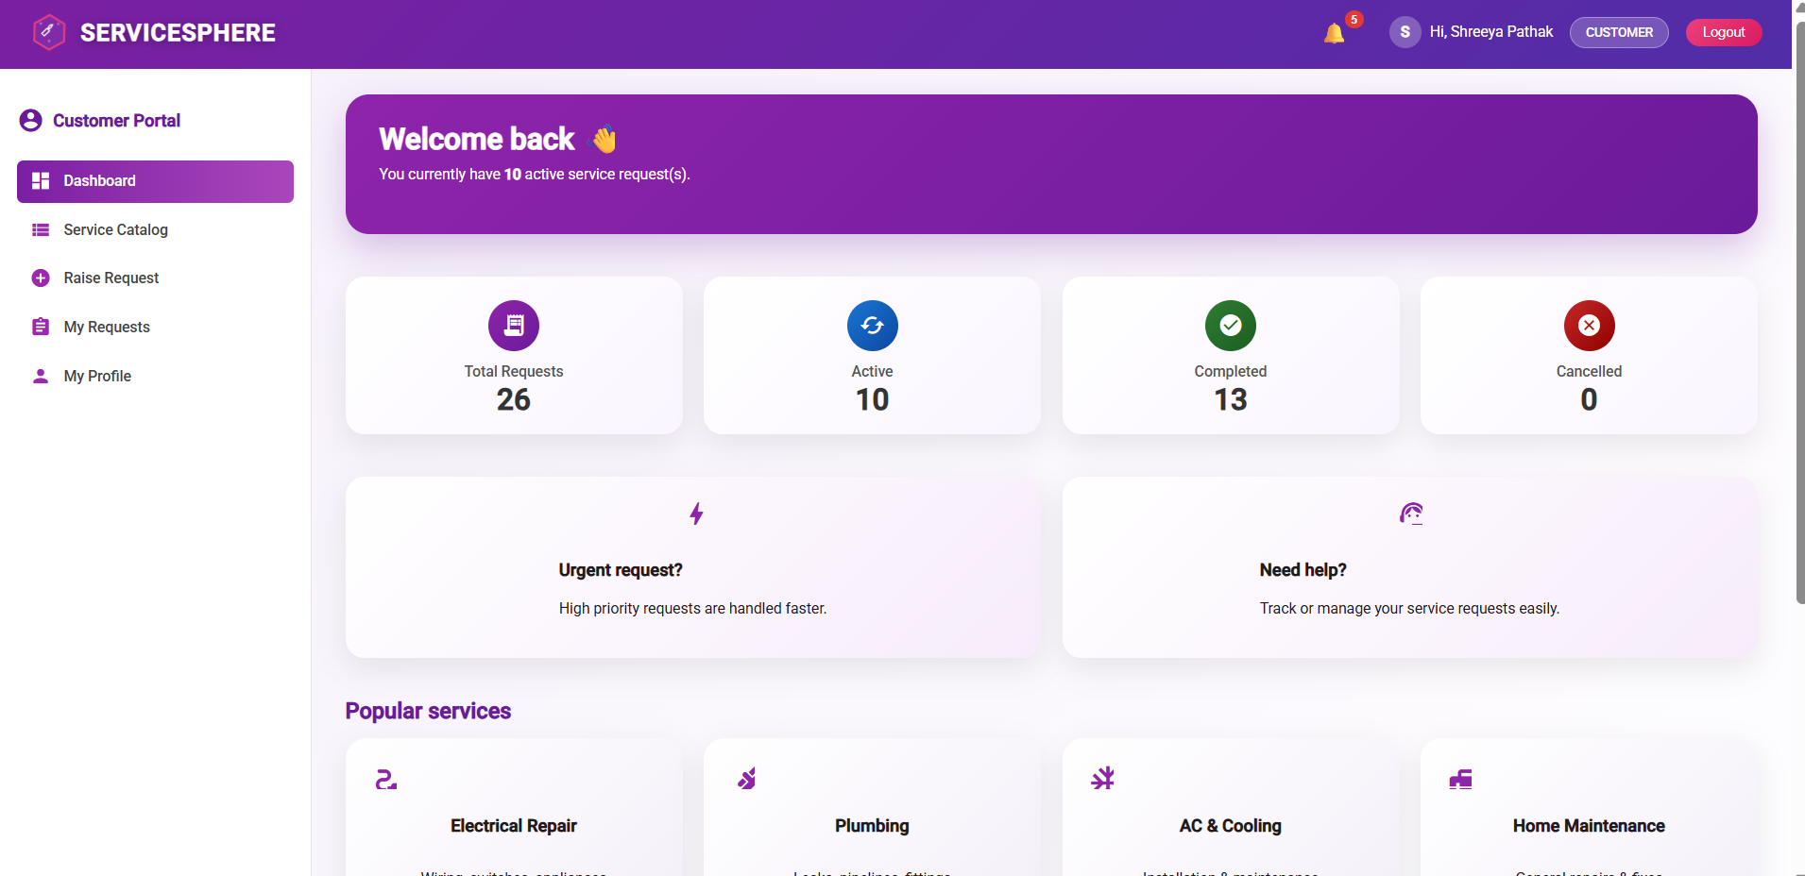
CUSTOMER DASHBOARD
Architecture
Construction
Urban Planning

Slide 12
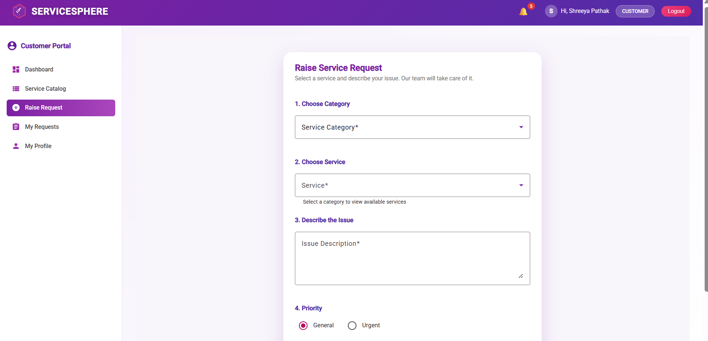
CUSTOMER MAKES SERVICE REQUEST
Architecture
Construction
Urban Planning

Slide 13
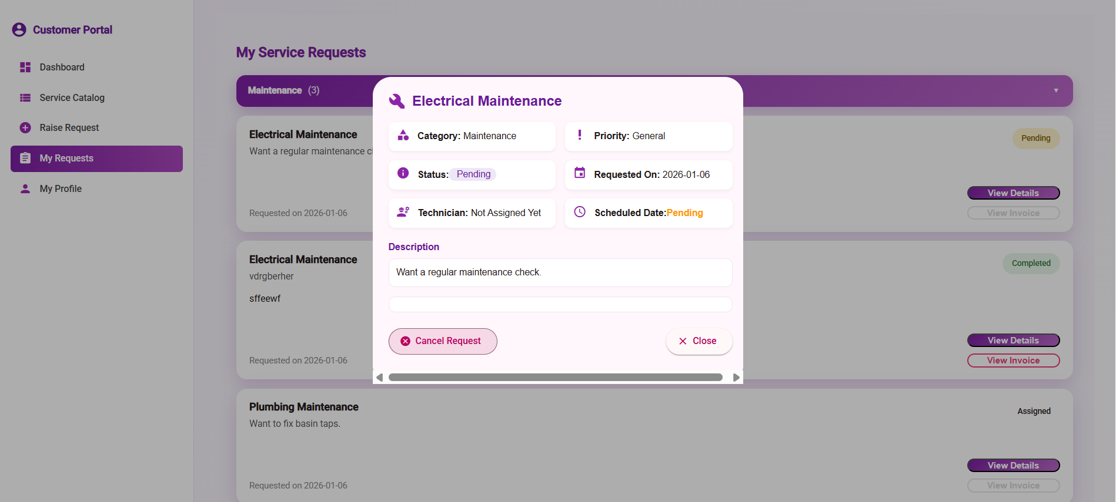
TRACK THEIR REQUEST STATUS
Architecture
Construction
Urban Planning

Slide 14
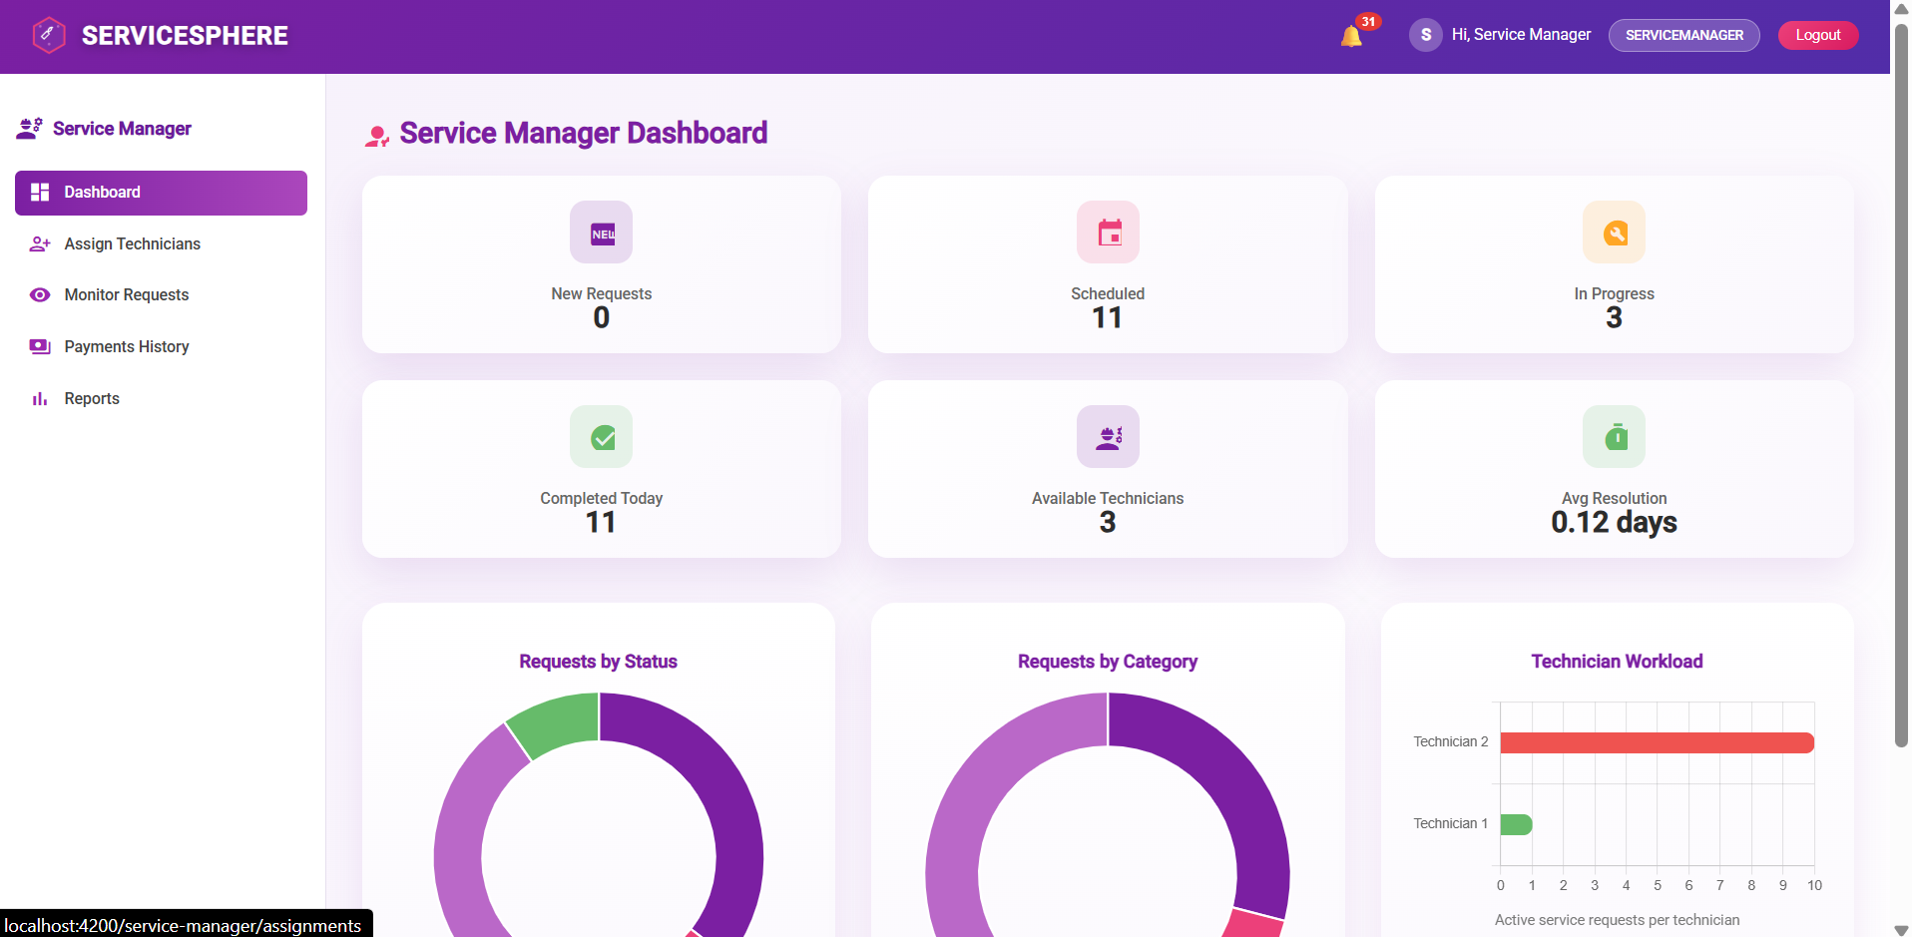
SERVICE MANAGER DASHBOARD
Architecture
Construction
Urban Planning

Slide 15
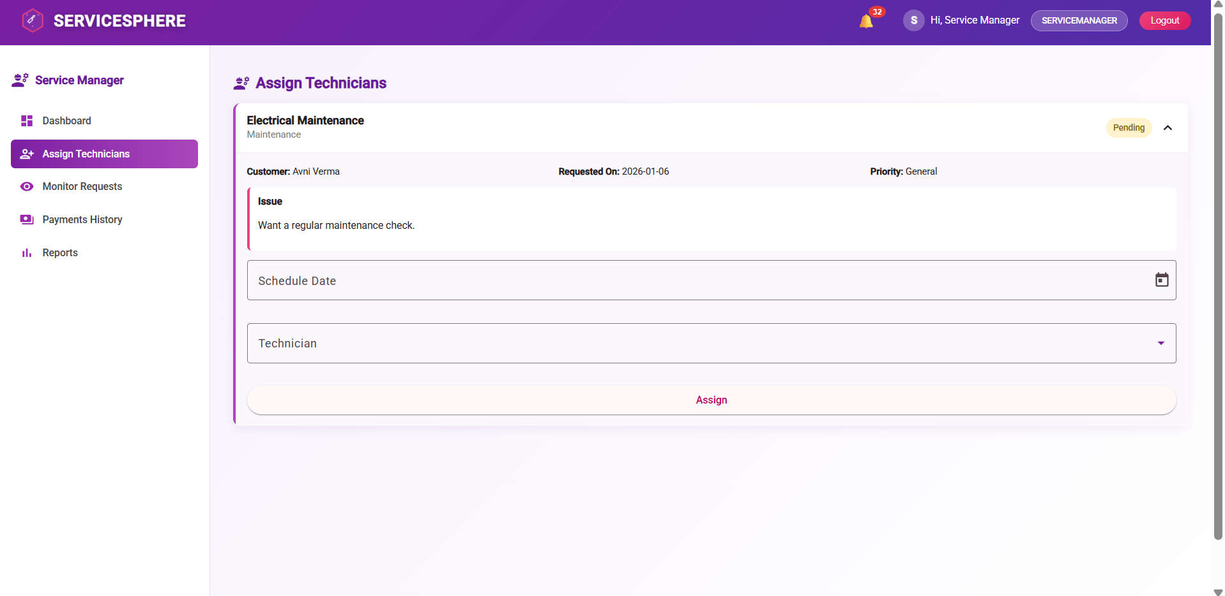
TECHNICIAN ASSIGNMENT
Architecture
Construction
Urban Planning

Slide 16
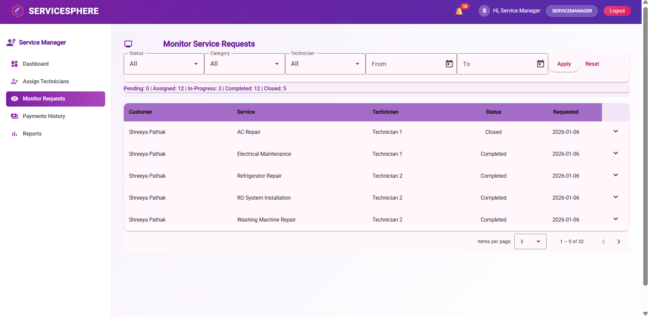
MONITORS REQUESTS
Architecture
Construction
Urban Planning

Slide 17
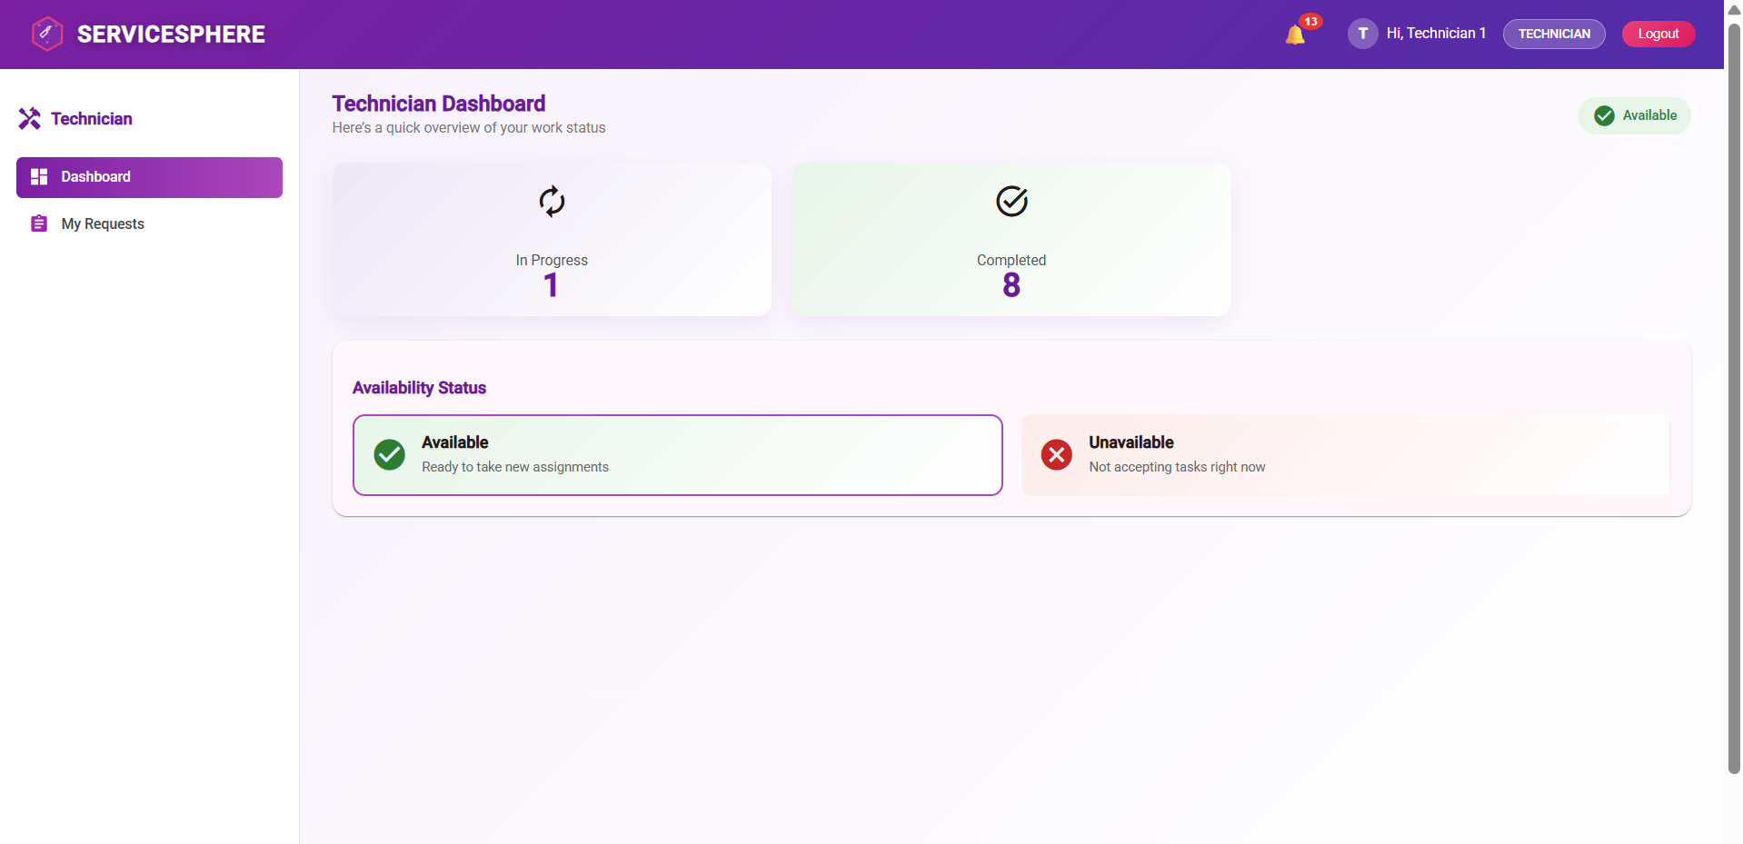
TECHNICIAN DASHBOARD
Architecture
Construction
Urban Planning

Slide 18
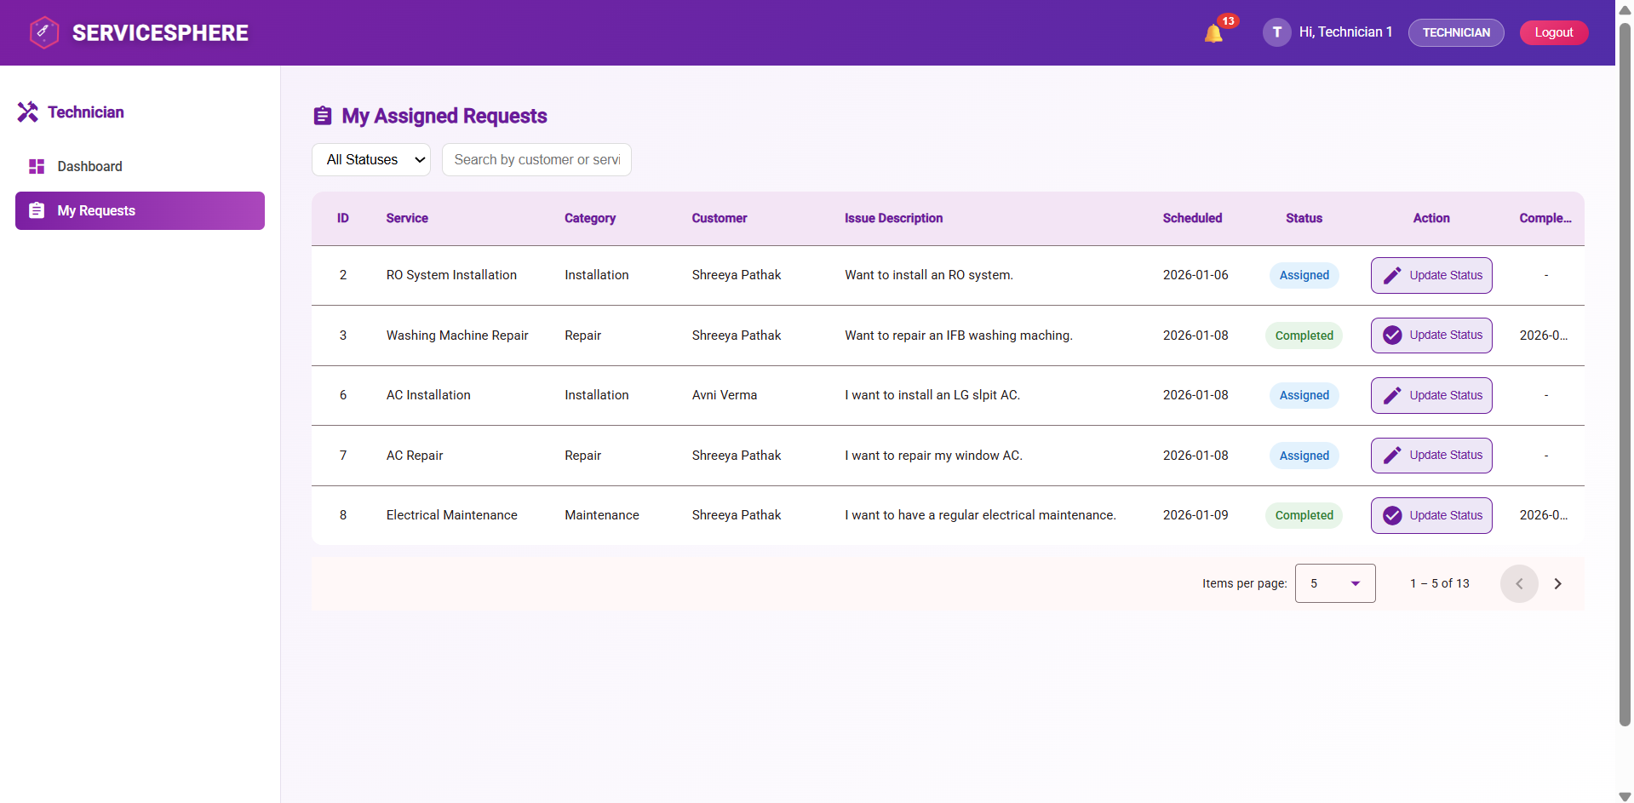
MONITORS ASSIGNED REQUESTS
Architecture
Construction
Urban Planning

Slide 19
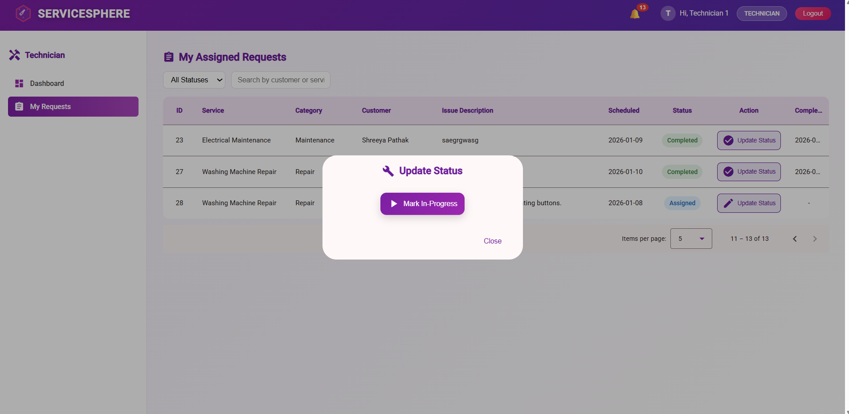
UPDATES SERVICE STATUS
Architecture
Construction
Urban Planning

Slide 20
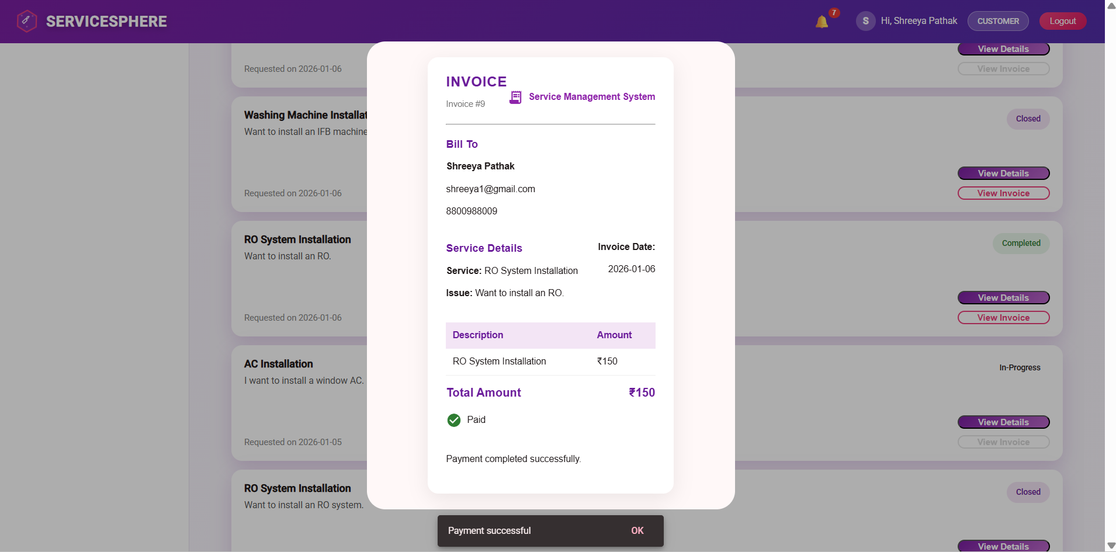
INVOICE GENERATED AND PAYMENT MADE
Architecture
Construction
Urban Planning

Slide 21
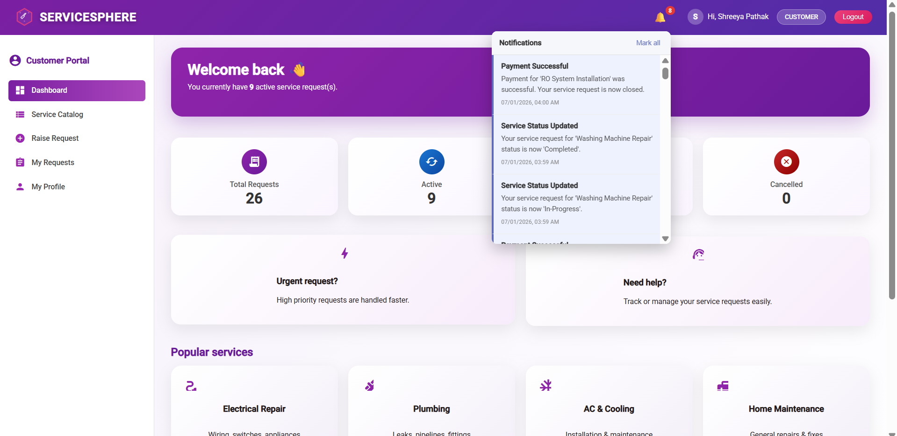
CUSTOMISED NOTIFICATIONS
Architecture
Construction
Urban Planning

Slide 22
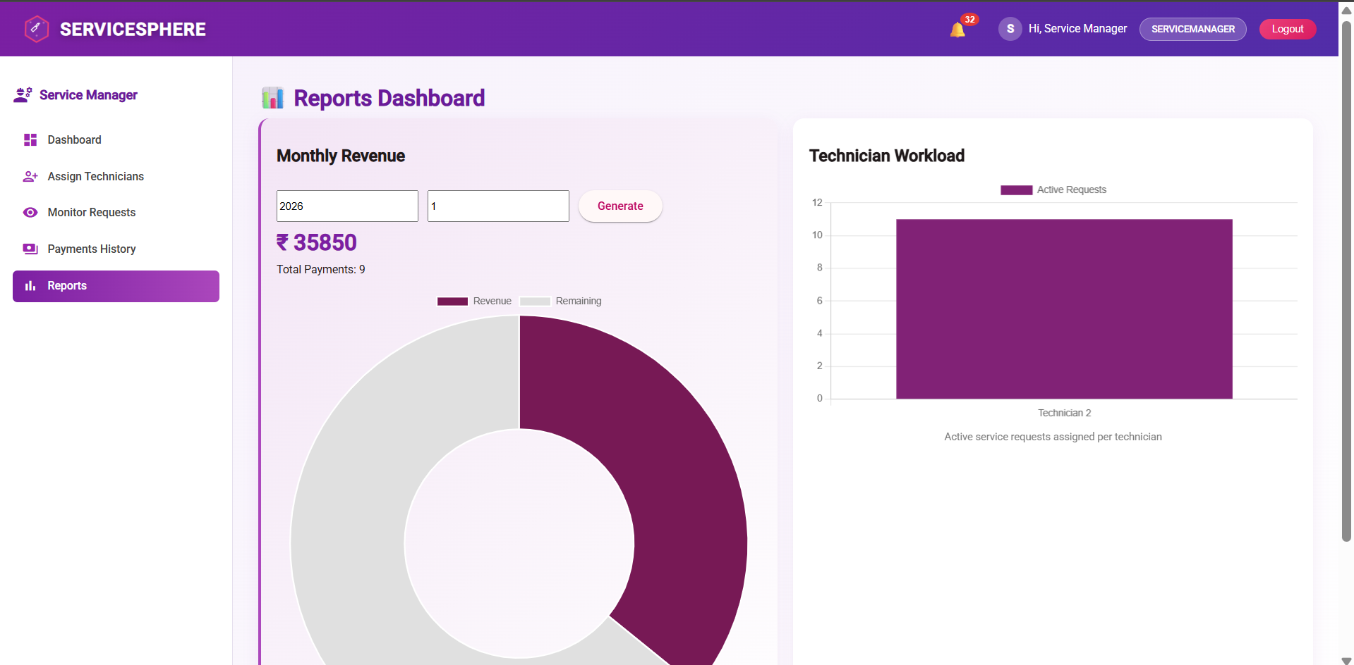
REPORTS AND ANALYTICS
Architecture
Construction
Urban Planning

Slide 23
RESULTS AND ACHIEVEMENTS
Successful End-to-End Service Management Automation
Role-Based Access Control (RBAC) Implementation
Efficient Service Request Tracking
Integrated Invoice and Payment Management

Slide 24
LIVE DEMO.

Slide 25
THANK YOU

